Slide 1
RL for Travelling Salesman Problem
AI 832 / Reinforcement Learning
Course Project
Group 16
Prem Shah (IMT2020044)
Mayank Chadha (IMT2020045)
Shridhar Sharma (IMT2020065)

Slide 2
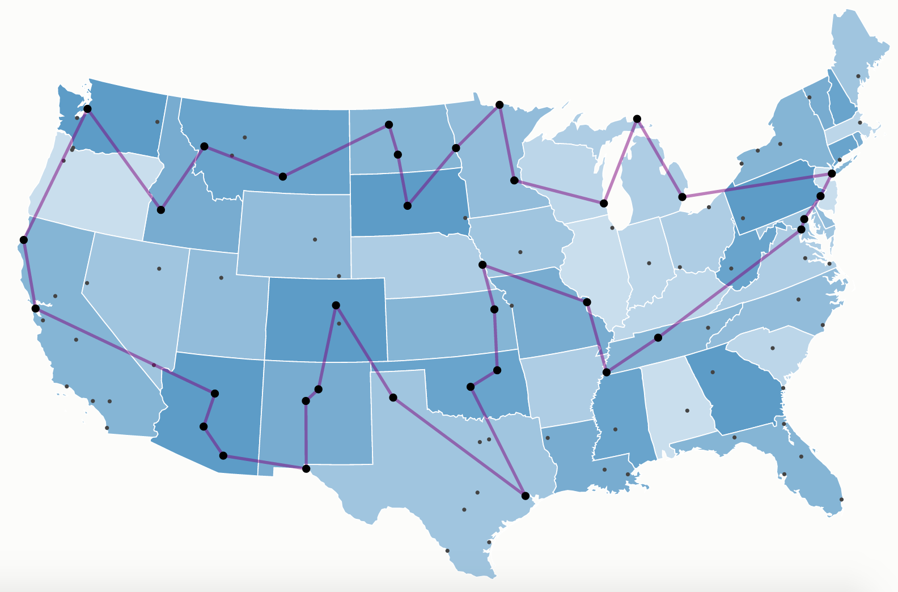
Problem Description
The Travelling Salesman Problem (TSP) is an NP-hard problem (N! complexity)
TSP and its variants have wide ranging application –
Vehicle and Network Routing
Computing DNA Sequences
Scheduling Jobs on Machines
By continuously learning through trial and error, the RL agent can discover optimal routes that traditional heuristic algorithms might miss.
RL allows for incorporating dynamic elements.
Imagine a salesman encountering unexpected traffic jams or road closures.
An RL agent could adapt its route in real-time based on these unforeseen situations.

Slide 3
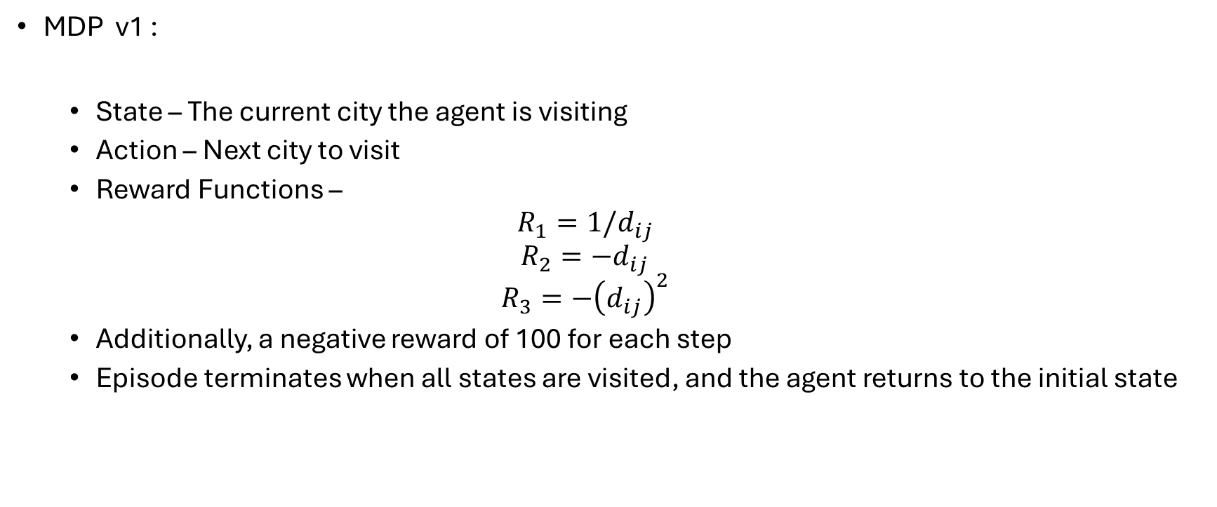
MDP Formulation
MDP v1 :
State – The current city the agent is visiting
Action – Next city to visit
Reward Functions –
$$R_{1}=1/d_{ij}$$
$$R_{2}=−d_{ij}$$
$$R_{3}=−{\left(d_{ij}\right)}^{2}$$
Additionally, a negative reward of 100 for each step
Episode terminates when all states are visited, and the agent returns to the initial state

Slide 4
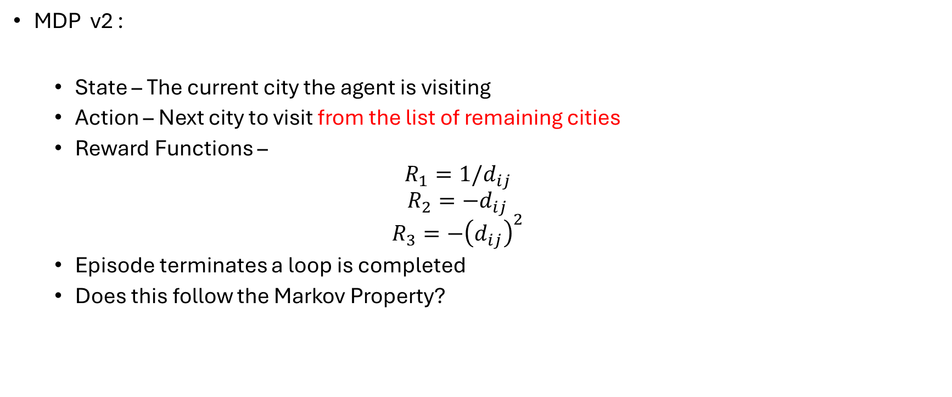
MDP Formulation
MDP v2 :
State – The current city the agent is visiting
Action – Next city to visit from the list of remaining cities
Reward Functions –
$$R_{1}=1/d_{ij}$$
$$R_{2}=−d_{ij}$$
$$R_{3}=−{\left(d_{ij}\right)}^{2}$$
Episode terminates a loop is completed
Does this follow the Markov Property?

Slide 5
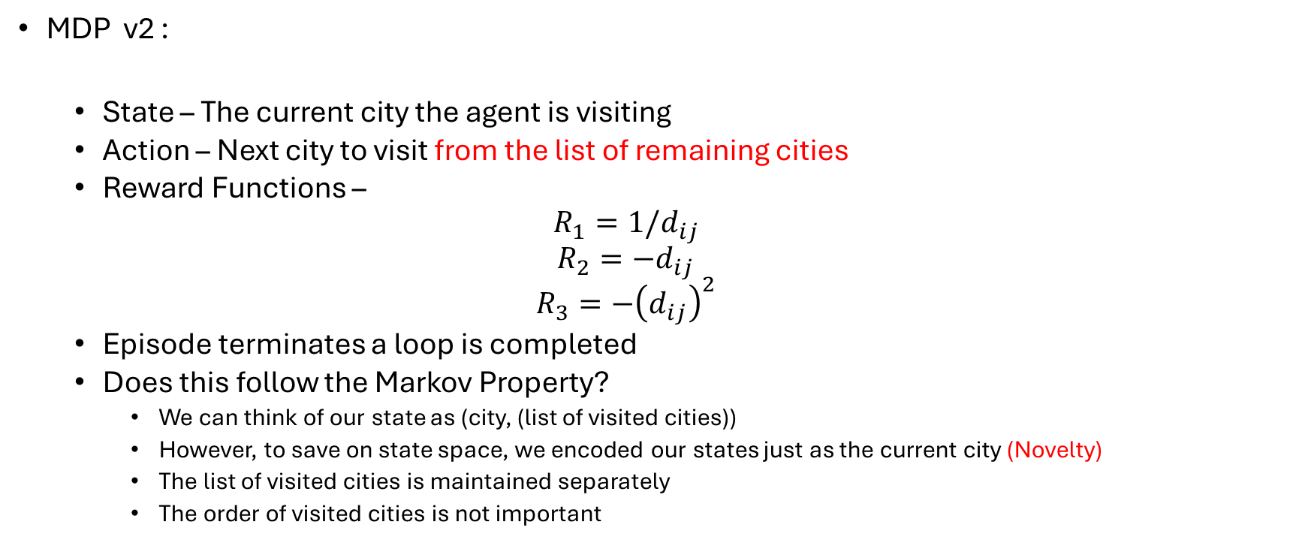
MDP Formulation
MDP v2 :
State – The current city the agent is visiting
Action – Next city to visit from the list of remaining cities
Reward Functions –
$$R_{1}=1/d_{ij}$$
$$R_{2}=−d_{ij}$$
$$R_{3}=−{\left(d_{ij}\right)}^{2}$$
Episode terminates a loop is completed
Does this follow the Markov Property?
We can think of our state as (city, (list of visited cities))
However, to save on state space, we encoded our states just as the current city (Novelty)
The list of visited cities is maintained separately
The order of visited cities is not important

Slide 6
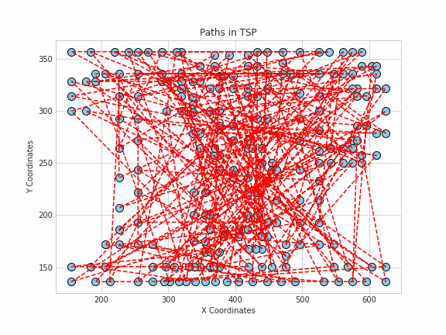
Environment Creation
The environment created in python (without gym) and consists of –
The distances between each pair of node
Keeps track of all the nodes visited so far
Reward functions and Plotting functions
The initial state is chosen randomly
Dataset - TSPLIB (uni-heidelberg.de)

Slide 7
Algorithms and Performance
All algorithms implemented in Python

Slide 8
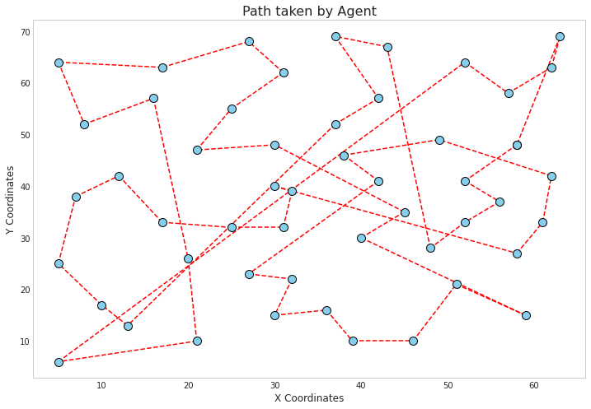
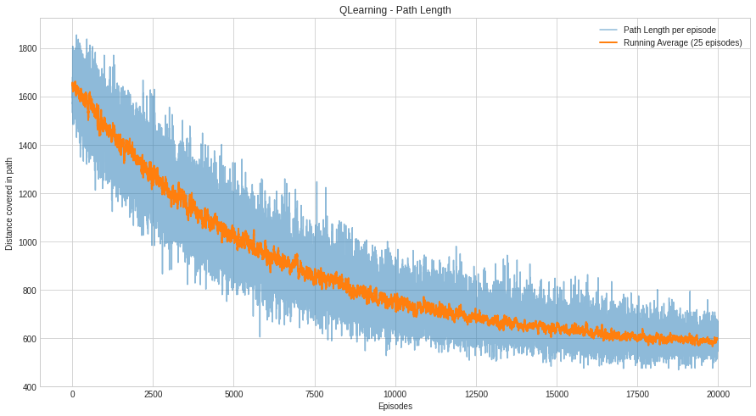
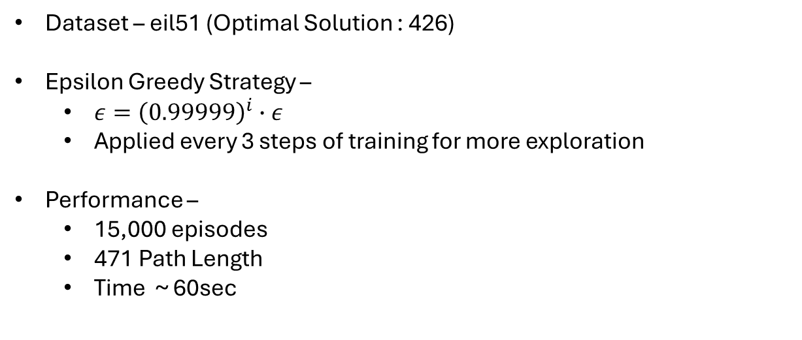
Q-Learning
Dataset – eil51 (Optimal Solution : 426)
Epsilon Greedy Strategy –
$ε={\left(0.99999\right)}^{i}∙ε$
Applied every 3 steps of training for more exploration
Performance –
15,000 episodes
471 Path Length
Time ~ 60sec

Slide 9
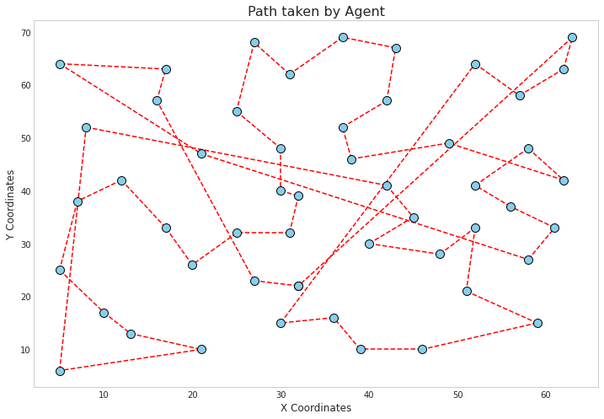
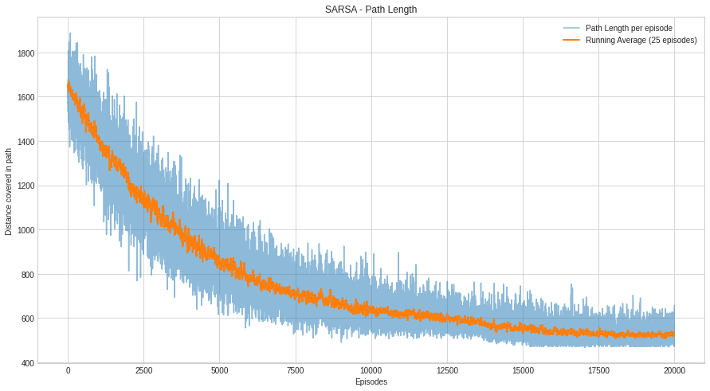
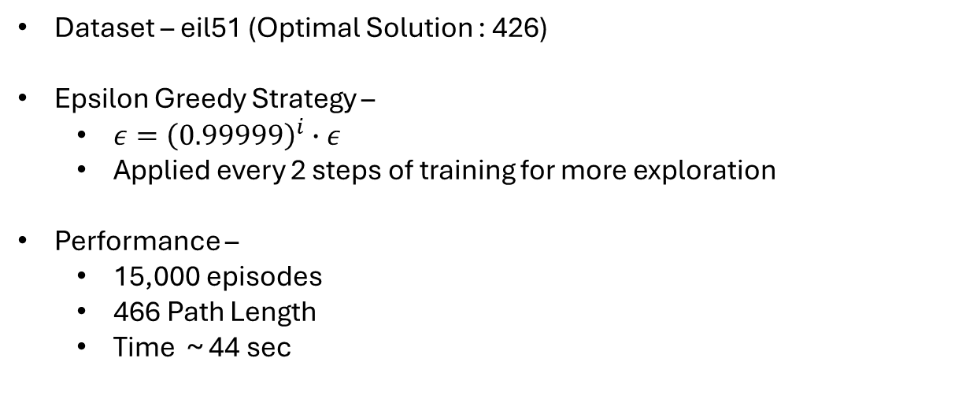
SARSA
Dataset – eil51 (Optimal Solution : 426)
Epsilon Greedy Strategy –
$ε={\left(0.99999\right)}^{i}∙ε$
Applied every 2 steps of training for more exploration
Performance –
15,000 episodes
466 Path Length
Time ~ 44 sec

Slide 10
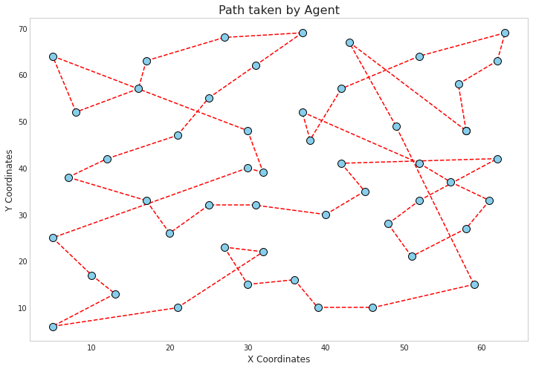
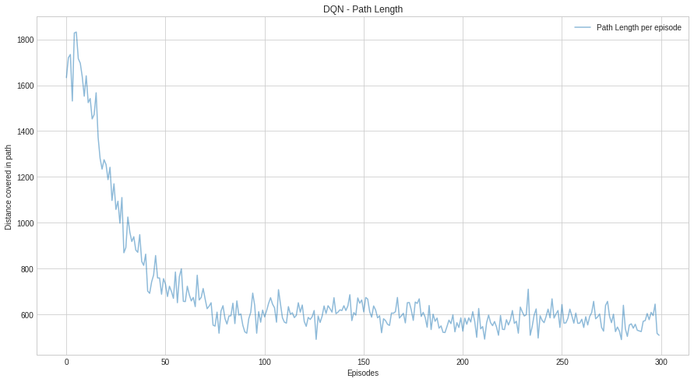
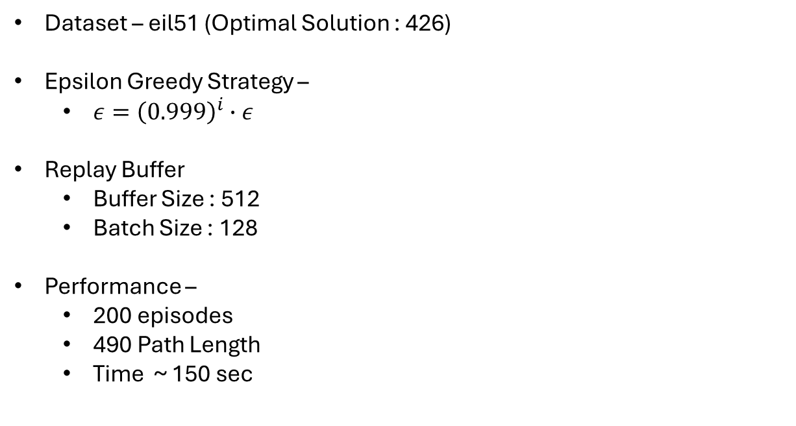
DQN (Deep Q-Network)
Dataset – eil51 (Optimal Solution : 426)
Epsilon Greedy Strategy –
$ε={\left(0.999\right)}^{i}∙ε$
Replay Buffer
Buffer Size : 512
Batch Size : 128
Performance –
200 episodes
490 Path Length
Time ~ 150 sec

Slide 11
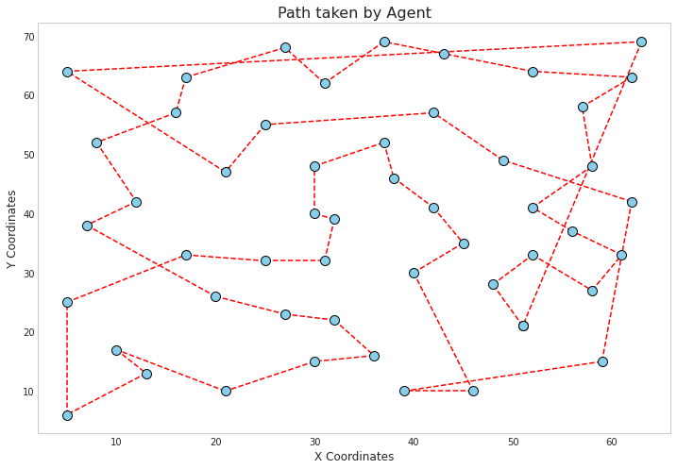
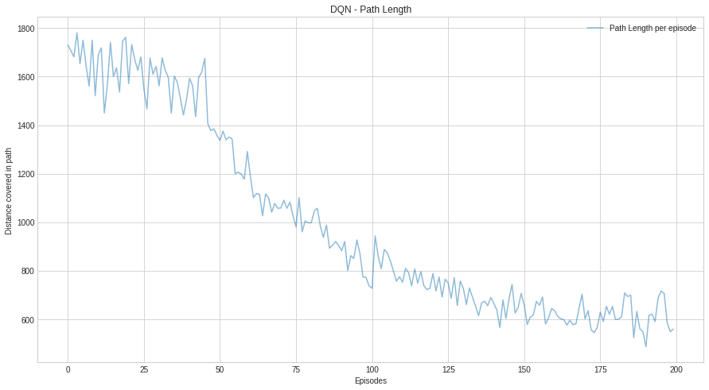
Double DQN
Dataset – eil51 (Optimal Solution : 426)
Use two Neural Networks to reduce variance
Performance –
200 episodes
486 Path Length
Time ~ 180 sec

Slide 12
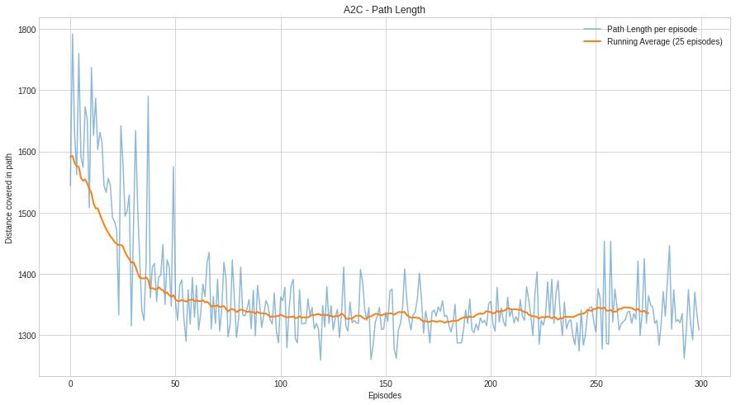
A2C (Actor Critic with Baseline)
Dataset – eil51 (Optimal Solution : 426)
Baseline used – Advantage Function
Performance –
300 episodes
1259 Path Length
Less exploration?
Replay Buffer
Epsilon Greedy
Soft-Actor Critic

Slide 13
Asymmetrical TSP
In ATSP problems, the distance between cities is not equal or there are one-way paths.
More challenging to solve
ATSP has more practical applications like traffic conditions, blocked roads, etc.

Slide 14
Comparison
Algorithm | Eil51 (TSP) | Tsp255 (TSP) | Br17 (ATSP)
Q-Learning | 471 | 5852 | 39
SARSA | 466 | 5843 | 39
DDQN | 486 | 6948 | 39
A2C | 1259 | - | -
Optimal | 426 | 3916 | 39
SA (Baseline) | 467 | 6853 | -
ACO Optimized | 441 | - | -
SA : Simulated Annealing (Most popular heuristic to solve TSP)
ACO : Ant Colony Optimization (Similar to Multi Agent RL setups)
Simulated Annealing
Benchmarking Metaheuristic Optimization Algorithms on Travelling Salesman Problems (acm.org)

